Slide 1
The California Gas Tax Swap Learning from a Failed Experiment
Martin Wachs
Distinguished Professor Emeritus
Department of Urban Planning
UCLA

Slide 2
Prior to the 2010 Swap
State Excise Taxes on Fuel
State General Sales Tax on Fuel
Enacted in 1922
State tax of 18¢/gal on gas & 24¢/gal on diesel; rate last increased in 1990
Protected for transportation uses by Article XIX of CA Constitution
Used mostly for transportation capital; O&M and local return to cities & counties
Since 1971 “Transportation Development Act “
Gasoline previously exempted
General sales tax rate was in 2010 7.5% to 9.5% depending on the county
Not protected but proceeds from fuel taxation were used to pay off transportation bonds & for state assistance to public transit

Slide 3
Important California Context
To impose any “new tax” requires passage by supermajority of 2/3 of Assembly & Senate
Governors Davis & Schwartzenegger declared fiscal emergencies in 2008, 2009, and 2010 as deficits exceed $11b, $24b, and $34b in those years
The emergency declaration allowed the sales tax revenue on fuel to be used for other general purposes; reduced an already strained transportation fund; excise tax revenue used for transportation bond payments

Slide 4
The Gas Tax Swap - 2010
Eliminated (unprotected) sales tax on motor fuel and created a (protected) “variable” excise tax
To avoid 2/3 votes, it was intended to be revenue neutral - to produce as much revenue as the sales tax did
CA Board of Equalization (elected tax oversight board) revises the excise tax rate (up or down) annually to insure revenue neutrality using data from the CA Department of Finance

Slide 5
Three-step Methodology to Adjust the
Variable Gasoline Excise Tax
Example from FY 2014-15

Slide 6
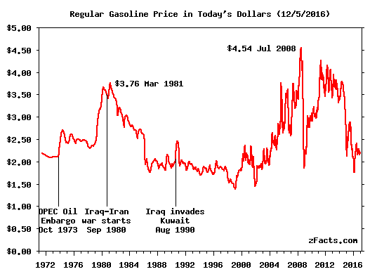
The Price of Fuel is Volatile & the Excise Tax Rose and then Fell

Slide 7
Revenue from Both Excise Taxes Since Swap

Slide 8
Base & Variable Per Gallon Excise Tax

Slide 9
Revenue from Diesel Excise Tax Since the Swap

Slide 10
STIP and SHOPP revenues under the gas tax swap.
STIP = State Transportation Improvement Program
SHOPP = State Highway Operation and Protection Program

Slide 11
Revenue Allocations by Major Program

Slide 12
Eliminated sales tax vs. variable gasoline excise tax revenues.

Slide 13
Forecast variable gasoline excise tax revenues.

Slide 14
The Swap is Considered a Failure
It did deal with “protection” for transportation use of fuel tax revenue, but was short-sighted because is did not address the underlying volatility in the revenue stream
The state transportation program requires increased revenue as well as stability in the revenue stream

Slide 15
Pending Measures Now
Governor’s 2016 Special Session of Legislature failed to enact new transportation revenue
Both AB 1 and SB 1 now pending propose to:
Increase annual vehicle registration fees
Charge electric vehicles an extra $165 annual fee
Eliminate the Swap and adopt a 17¢/gal increase in the excise tax indexed and revised annually
CA RC Test in the Field – Intent is to adopt a mileage based user fee to succeed the fuel tax within several years

Slide 16
Takeaways
Motor fuel taxes can increase revenue in only two ways:
If tax per gallon increases
If gallons consumed increase
Shifting from excise tax per gallon to sales tax did not address this reality and introduced unexpected volatility, was politically expedient but did not address the underlying revenue problem
Mileage based user fee also needs to rise over time to insure increased revenue over time

Slide 17
Thank you
For More Details see: Anne Brown, Mark Garrett, & Martin Wachs The California Gas Tax Swap, May 2016
http://www.its.ucla.edu/wp-content/uploads/sites/6/2016/08/Gas-Tax-Swap-FINAL-REPORT-052706.pdf
The study was supported by the University of California Center on Economic Competitiveness in Transportation (UC CONNECT), the federally funded University Transportation Center for Region IX

